Slide 1
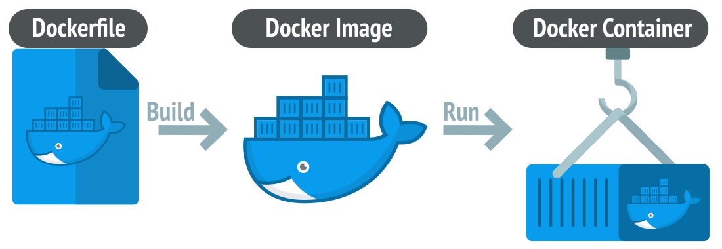
Containers
https://bit.ly/B22334

